Slide 1

Traffic Crash Analysis on Chicago Dataset
Group Name: Data Pioneers
Group Members:
Janhavi Kharmale
Garima Dubey
Raajitha Sai
Ruthvik Bacha

Slide 2
Introduction
Objective:
Analyze trends in traffic incidents to understand key patterns and factors.
Predict crash severity using machine learning models to support proactive safety measures.
Data Source:
Chicago Data Portal - Traffic Incidents Dataset
Comprehensive records of traffic incidents in Chicago, covering various attributes related to incident details and severity.

Slide 3
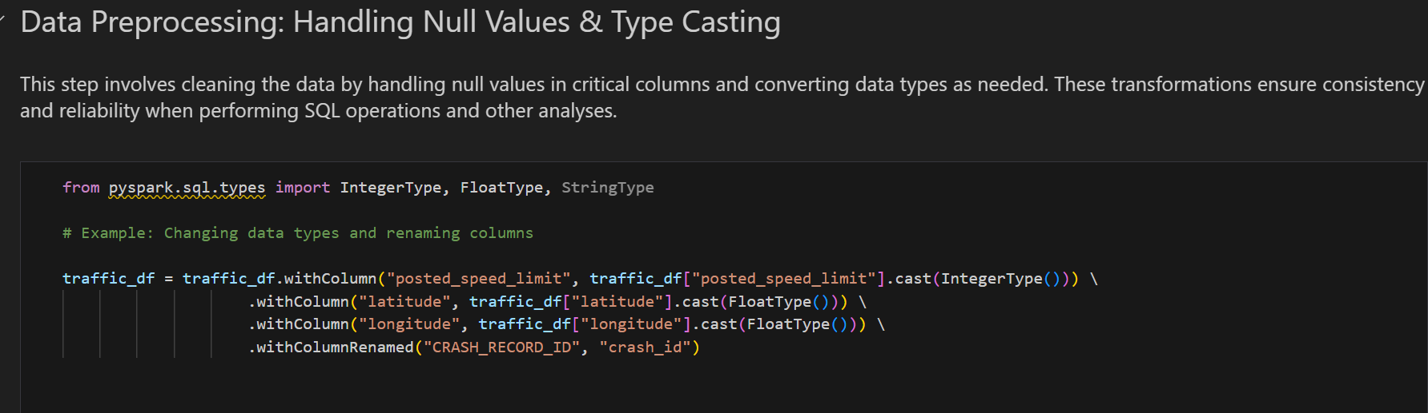
Data and Methodology
Steps:
Data loading and setup using PySpark
Data cleaning: Handling null values, type casting
Exploratory Data Analysis (EDA) to identify key patterns and trends

Slide 4
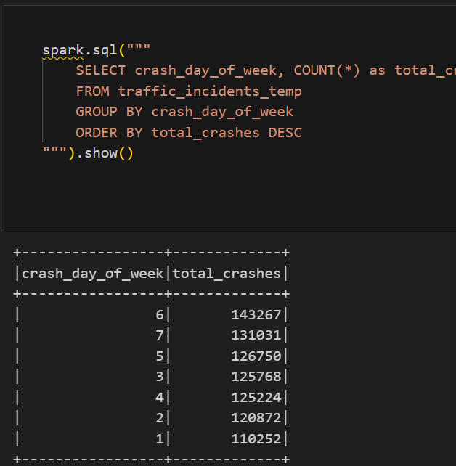
Key Insights from EDA
Crash Incidents by Day of the Week:
Investigates the frequency of traffic incidents across different days of the week, helping identify patterns in crash occurrences. By analyzing which days have the highest number of crashes, we can gain insights into the days with increased accident risks, potentially related to traffic volume or behavioral patterns.

Slide 5
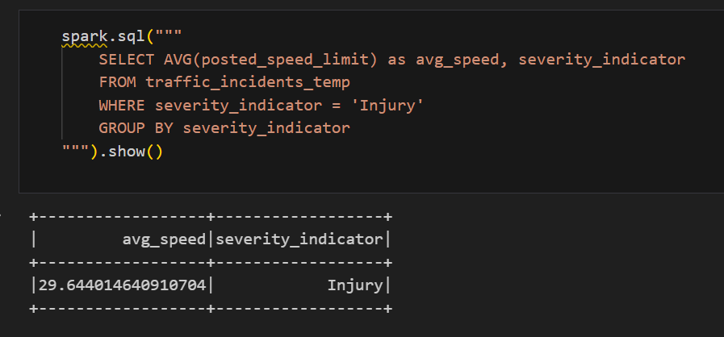
Key Insights from EDA
Analysis of Average Posted Speed Limit for Injury-Related Incidents:
This analysis aims to investigate whether there is a correlation between posted speed limits and incidents that result in injuries. By calculating the average speed limit at locations where injury-related incidents occurred, we can gain insights into whether higher speed limits contribute to more severe incidents.

Slide 6
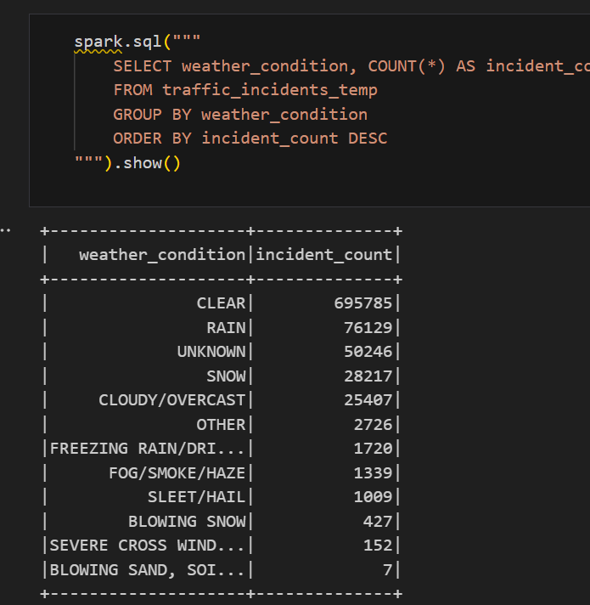
Key Insights from EDA
Analysis of Incident Counts by Weather Condition:
This analysis focuses on examining how different weather conditions correlate with the frequency of traffic incidents. Using the `traffic_incidents_temp` view, we group incidents by `weather_condition` to calculate the total number of incidents associated with each type of weather.

Slide 7
Conclusion
Our analysis of Chicago traffic crashes has provided critical insights into the factors affecting crash severity, including weather conditions, speed limits, lighting, and other external factors.
Key findings include strong correlations between specific weather conditions and crash severity, identification of high-risk zones.
These insights can support targeted interventions, inform traffic regulation policies, and guide urban planning efforts to reduce crash rates and improve road safety.
This project underscores the value of big data tools in advancing data-driven strategies for public safety and proactive traffic management.

Slide 8
Future Scope
Predictive Analysis:
Predictive analysis can inform proactive safety measures by adjusting speed limits in high-risk areas and improving lighting in vulnerable zones. These data-driven interventions help reduce crash severity, enhance visibility, and support safer traffic and infrastructure planning.
Adjust Speed Limits in High-Risk Areas:
In areas identified with frequent crashes, adjusting speed limits based on data insights can enhance road safety. Lowering speed limits in high-risk zones helps reduce crash severity by giving drivers more time to react.

Slide 9
Thank you!!!

